Slide 1
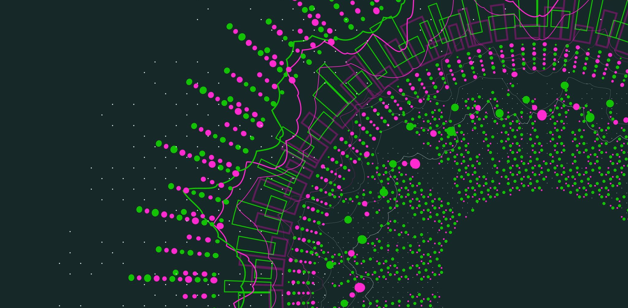
Text to Photo-Realistic Image Construction

Slide 2
Team Members
Done By Team:
Venkata Surya Sai Ram Nistala - 700747147
Vijitha Gajavelli - 700739707 Krishna Sai Srujan Teja Basetty - 700745299
Neeraj Kumar Kajuluri - 700742091

Slide 3
Contributions of the team members
Sairam:-Applying and assessing StackGAN analysis, execution, and programming, with the outcomes being added to the reports, StackGAN++ deployment and training.
Srujan:- Complete analyses of DALL E and DALL E2, along with a brief attachment of that data and concepts.
Vijitha: Investigating everything and composing a thorough project report, researching the DALL-E2 architecture.
Neeraj:-The application of StackGAN++ (StackGAN-V2) analysis, execution, and programming is evaluated, and the outcomes are then added to the reports.

Slide 4
Motivation
The aim of text-to-photorealistic picture synthesis is to close the gap between computer vision and natural language understanding. Even though text and images are both important sources of information, their very different ways of being communicated. Researchers are developing algorithms that can generate photo-realistic images from verbal inputs in order to create a more seamless interface between these two modalities.
Our intention is to study the multiple ways of achiving this task and come up with the one which is best and also to understand the achivements done in this field and the potential outcomes in communication and other fields.

Slide 5
Objective
Identify and analyze the key techniques and methodologies used in text to image generation ML algorithms, including generative adversarial networks (GANs), variational autoencoders (VAEs), and attention mechanisms.
Evaluate the performance of different text to image generation models, and compare their strengths and weaknesses in terms of factors such as image quality, semantic consistency, and diversity of output.
Investigate the impact of various factors on text to image generation, such as the quality and size of the training dataset, the choice of loss function, and the use of pre-trained models.
Assess the limitations of existing text to image generation models, and identify opportunities for future research, such as improving the generation of fine-grained details, or incorporating additional modalities such as audio or video.
Explore the practical applications of text to image generation, such as virtual reality, e-commerce, and creative content generation, and examine how ML models can be integrated into these domains to enhance their capabilities.

Slide 6
Related Work
We are examining and contrasting 4 different algorithms as part of the text to photo-realistic image construction.
1. StackGAN
2. StackGAN++ (StackGAN-V2) 3. DALL-E
4. DALL-E 2

Slide 7
StackGAN: Stacking two GANs on top of one another to form a network that can generate high-resolution and high-quality images is the basis of the StackGAN design. Its two stages are Stage I and Stage II. Using text embedding with restrictions, the Stage-I network generates low-resolution images with simple colors and rough sketches, while the Stage-II network scales up the Stage-I network's images to generate high-resolution images based on the supplied text embeddings.
StackGAN++ (StackGAN-V2):
StackGAN++ expands on the original StackGAN design by integrating a cascaded refinement network, which adds additional details and improves the visual quality of the resulting image. In comparison to StackGAN, which only contains two GANs, StackGAN++ has more GANs, and the generators are connected in a tree-like structure. All of the generators in this network are trained concurrently, in contrast to StackGAN, where generators are taught sequentially.

Slide 8
DALL-E:
DALL-E uses a variation of the GPT-3 model with 12 billion parameters. The GPT-3 text generation model generates text that resembles human writing. Using a big text dataset, it was trained. DALL-E extends the text generation capability of the GPT-3 model to include the generation of images. The training data for the transformer language model DALL-E consisted of a sizable dataset of picture-text pairs encoded into 1280 tokens (1024 tokens for image representation and 256 tokens for text representation).
DALL-E 2:
The 3.5 billion parameters of the DALL-E 2 architecture use a diffusion model that depends on CLIP image embeddings. Contrastive Language-Image Pre-Training, or CLIP, is a model that has already been taught to distinguish between similarities and differences between images and the textual descriptions that go along with them. CLIP picture embeddings can be produced by feeding CLIP text embeddings into a previous model. DALL-E 2 model features two stages. A text encoder initially converts the provided text description into a CLIP text embedding. The prior model (diffusion) inputs this CLIP text embedding to produce a CLIP image embedding in stage one. Stage two's decoder uses this CLIP image embedding as input to produce the final image.

Slide 9
Problem Statement
Text-to-image creation is a difficult job in machine learning that attempts to generate realistic pictures from textual descriptions.
The challenge is to create a complicated visual picture from a text description while ensuring that the resulting image is cohesive, realistic, and semantically linked with the input language.
This necessitates the model learning how to connect the underlying context, meaning, and structure of the text to a visual representation.
There are several uses for text-to-image generation, including virtual reality, gaming, and content development. However, because to the difficulty of the task and the necessity for vast volumes of high-quality data, it remains an active area of research.

Slide 10
Proposed Solution
We introduce a novel conditioning augmentation strategy that promotes smoothness in the latent conditioning manifold in order to broaden the variety of the synthesized images and stabilize the conditional-GAN training. Extensive tests and comparisons with industry-leading technologies on benchmark datasets show that the suggested strategy considerably improves the capability to produce photorealistic images based on text descriptions.

Slide 11
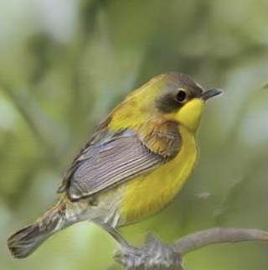
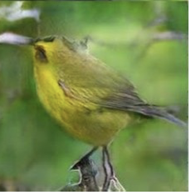
Results
StackGAN Results:
Text: “yellow coloured bird with black crown”
StackGAN++ Results:
Text: “yellow coloured bird with black crown”

Slide 12
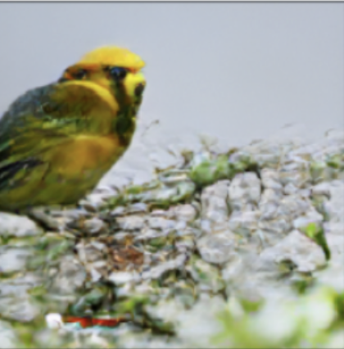
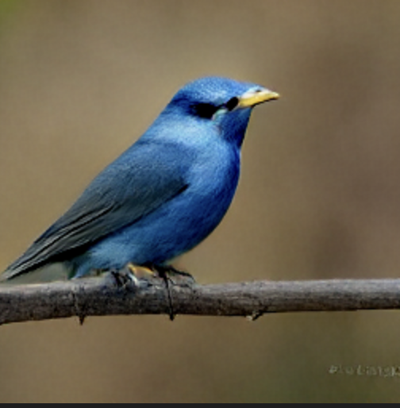
DALL-E Results:
Text: “yellow coloured bird with black crown”
Text: “A greyish-blue colored bird with a white-grey face, and big blue fee”

Slide 13
References
1.Ramesh, A., Dhariwal, P., Nichol, A., Chu, C., & Chen, M. (2022). Hierarchical text-conditional image generation with clip latents. arXiv preprint arXiv:2204.06125.
2.Rombach, R., Blattmann, A., Lorenz, D., Esser, P., & Ommer, B. (2022). High-resolution image synthesis with latent diffusion models. In Proceedings of the IEEE/CVF Conference on Computer Vision and Pattern Recognition (pp. 10684-10695).
3.Ramesh, A., Pavlov, M., Goh, G., Gray, S., Voss, C., Radford, A., ... & Sutskever, I. (2021, July). Zero-shot text-to-image generation. In International Conference on Machine Learning (pp. 8821-8831). PMLR.
4.Radford, A., Narasimhan, K., Salimans, T., & Sutskever, I. (2018). Improving language understanding by generative pre-training.
5.Nichol, A., Dhariwal, P., Ramesh, A., Shyam, P., Mishkin, P., McGrew, B., ... & Chen, M. (2021). Glide: Towards photorealistic image generation and editing with text-guided diffusion models. arXiv preprint arXiv:2112.10741.
6.Zhang, H., Xu, T., Li, H., Zhang, S., Wang, X., Huang, X., & Metaxas, D. N. (2018). Stackgan++: Realistic image synthesis with stacked generative adversarial networks. IEEE transactions on pattern analysis and machine intelligence, 41(8), 1947-1962.
7.Zhang, H., Xu, T., Li, H., Zhang, S., Wang, X., Huang, X., & Metaxas, D. N. (2017). Stackgan: Text to photo-realistic image synthesis with stacked generative adversarial networks. In Proceedings of the IEEE international conference on computer vision (pp. 5907-5915).
8.Doersch, C. (2016). Tutorial on variational autoencoders. arXiv preprint arXiv:1606.05908.
9.Gauthier, J. (2015). Conditional generative adversarial networks for convolutional face generation. In Tech Report.
10.Isola, P., Zhu, J. Y., Zhou, T., & Efros, A. A. (2017). Image-to-image translation with conditional adversarial networks. In Proceedings of the IEEE conference on computer vision and pattern recognition (pp. 1125-1134).

Slide 14
11.Child, R. (2020). Very deep vaes generalize autoregressive models and can outperform them on images. arXiv preprint arXiv:2011.10650.
12.Galatolo, F. A., Cimino, M. G., & Vaglini, G. (2021). Generating images from caption and vice versa via clip-guided generative latent space search. arXiv preprint arXiv:2102.01645.
13.Dhariwal, P., & Nichol, A. (2021). Diffusion models beat gans on image synthesis. Advances in Neural Information Processing Systems, 34, 8780-8794.
14.Koh, J. Y., Baldridge, J., Lee, H., & Yang, Y. (2021). Text-to-image generation grounded by fine-grained user attention. In Proceedings of the IEEE/CVF Winter Conference on Applications of Computer Vision (pp. 237-246).
15.Mansimov, E., Parisotto, E., Ba, J. L., & Salakhutdinov, R. (2015). Generating images from captions with attention. arXiv preprint arXiv:1511.02793.
16.Alayrac, J. B., Donahue, J., Luc, P., Miech, A., Barr, I., Hasson, Y., ... & Simonyan, K. (2022). Flamingo: a visual language model for few-shot learning. Advances in Neural Information Processing Systems, 35, 23716-23736.
17.Gao, Y., Liu, J., Xu, Z., Zhang, J., Li, K., Ji, R., & Shen, C. (2022). Pyramidclip: Hierarchical feature alignment for vision-language model pretraining. Advances in Neural Information Processing Systems, 35, 35959-35970.
18.Hu, X., Gan, Z., Wang, J., Yang, Z., Liu, Z., Lu, Y., & Wang, L. (2022). Scaling up vision-language pre-training for image captioning. In Proceedings of the IEEE/CVF Conference on Computer Vision and Pattern Recognition (pp. 17980-17989).
19.Reed, S., Akata, Z., Yan, X., Logeswaran, L., Schiele, B., & Lee, H. (2016, June). Generative adversarial text to image synthesis. In International conference on machine learning (pp. 1060-1069). PMLR.
20.Maximov, M., Elezi, I., & Leal-Taixé, L. (2020). Ciagan: Conditional identity anonymization generative adversarial networks. In Proceedings of the IEEE/CVF conference on computer vision and pattern recognition (pp. 5447-5456).

Slide 15


